Slide 1
Heuristic classifier
October 2024
Andrea Corrado

Slide 2
Outline
Why building a heuristic classifier
Knowledge on roving signals: recap
Heuristic classifier: pseudo code
Performance
Conclusions

Slide 3
Outline
Why building a heuristic classifier
Knowledge on roving signals: recap
Heuristic classifier: pseudo code
Performance
Conclusions

Slide 4
Why building a heuristic classifier
Problem
Which model could act as baseline for building and comparing any other one?
In literature there’s no evidence of AVNRT roving signals classification
Proposed solution
So, a first classifier, which could cover this role, could be a heuristic one based on the expectations on these signals
Aim
Building a logical set of rules to classify roving signals exploiting the expectations on them

Slide 5
Outline
Why building a heuristic classifier
Knowledge on roving signals: recap
Heuristic classifier: pseudo code
Performance
Conclusions

Slide 6
Knowledge on roving signals: recap
Map A
Amplitude >0.5 mv
Simple and biphasic shape of atrial wave
No slow-path signal
Minor presence of the Ventricular component
Map B
Complex atrial component within 0.1 and 0.3 mV
Higher ventricular component
Map C
3 components: atrial activity, ventricular activity and His Bundle passage
Not fixed proportions between atrial and ventricular components
Clear and biphasic atrial component

Slide 7
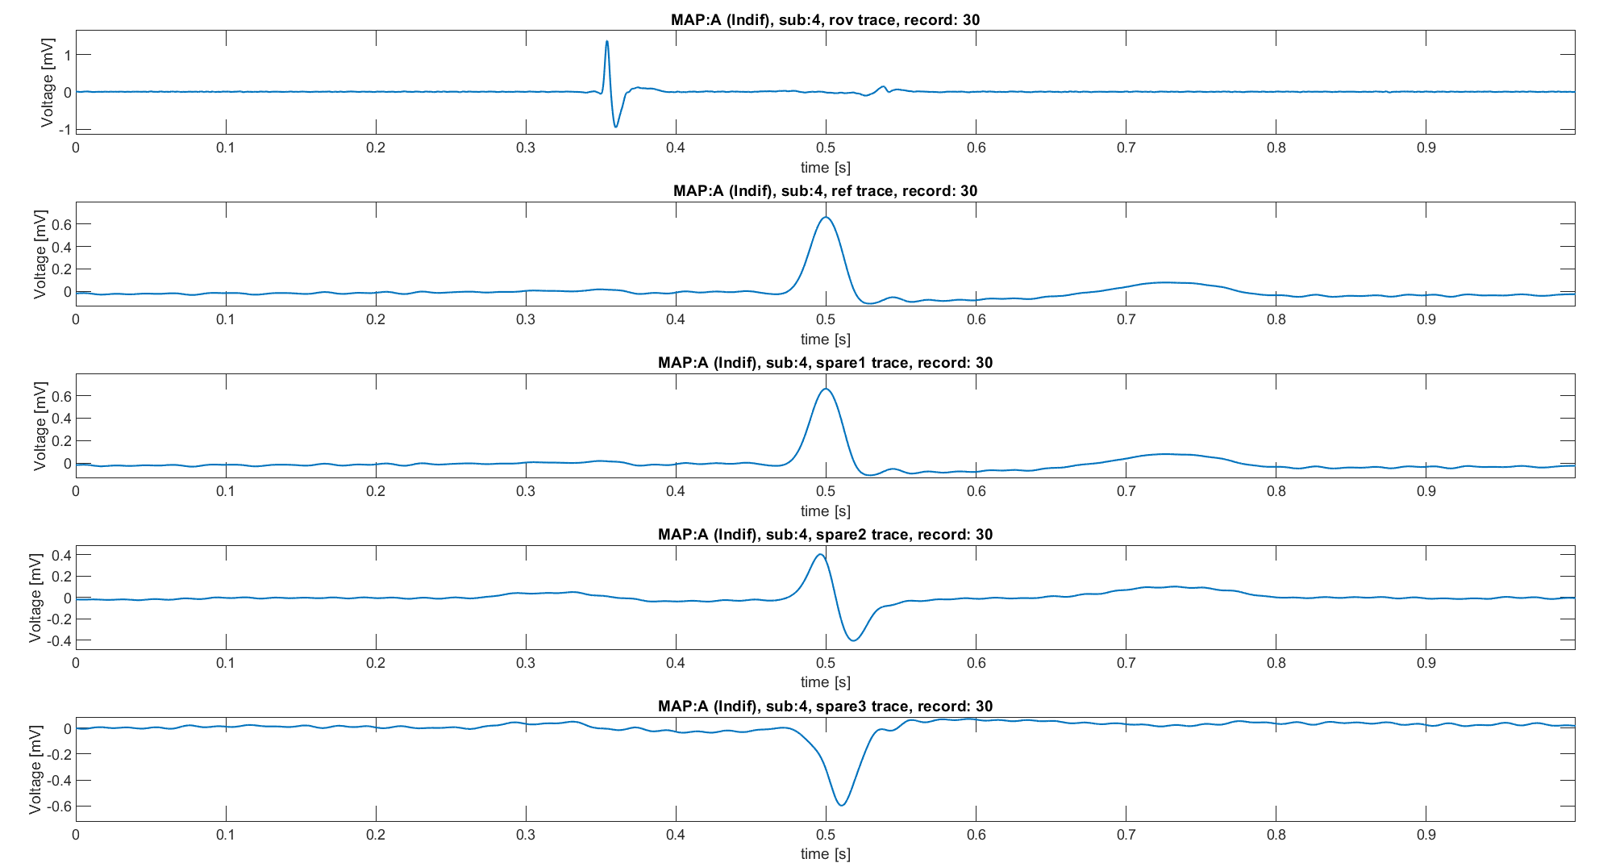
Knowledge on roving signals: recap
Map A
Amplitude >0.5 mv
Simple and biphasic shape of atrial wave
No slow-path signal
Minor presence of the Ventricular component
ECG 1
ECG 1
ECG 2
ECG 3

Slide 8
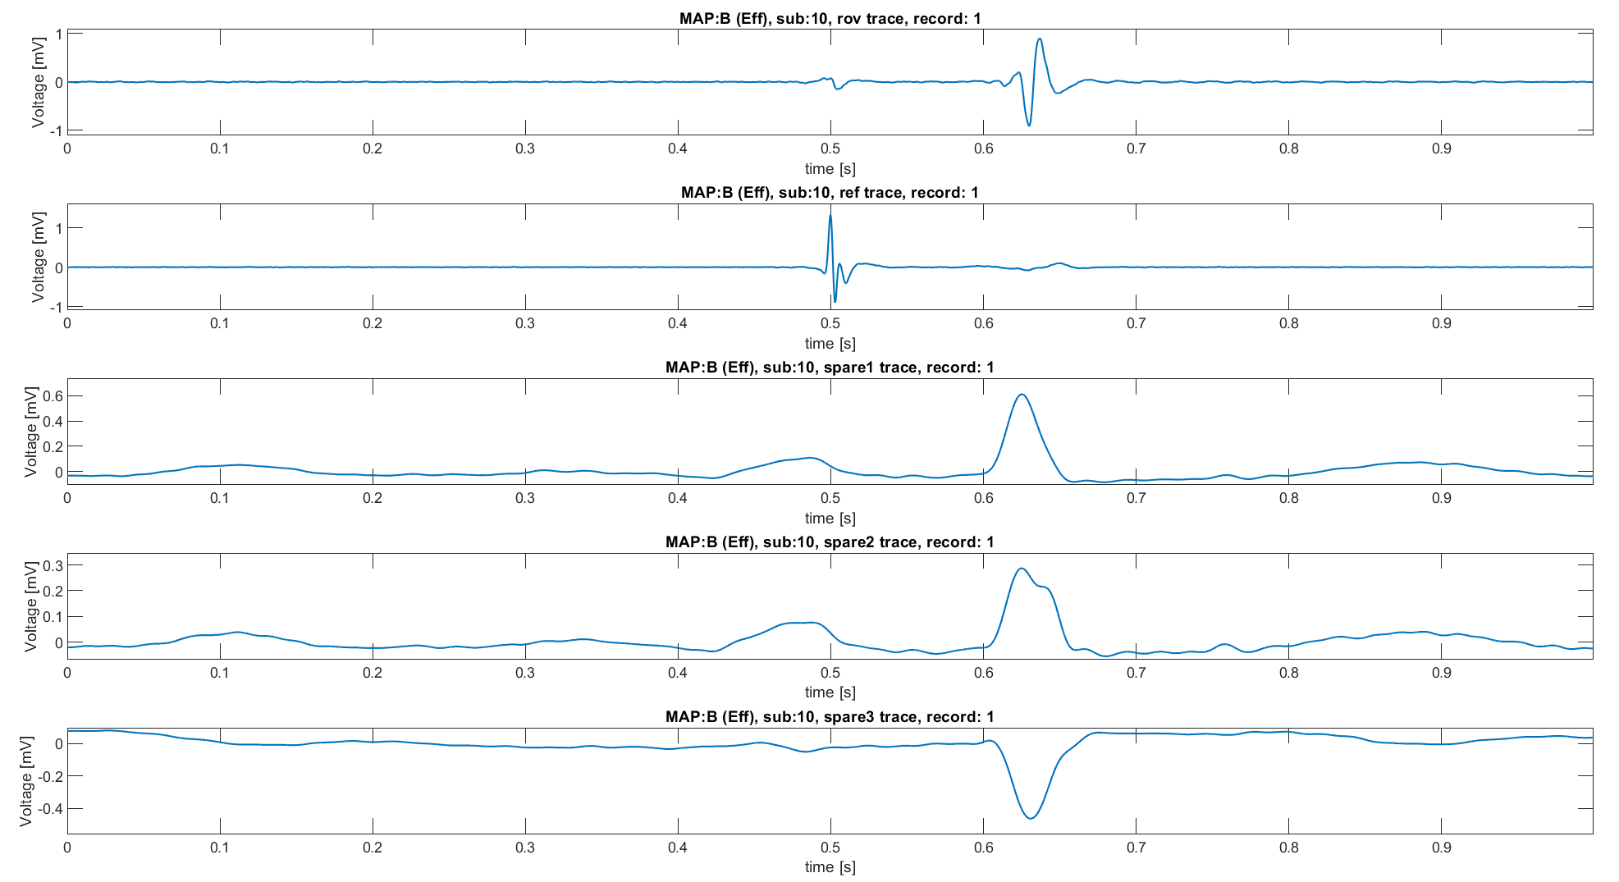
Knowledge on roving signals: recap
Map B
Complex atrial component within 0.1 and 0.3 mV
Higher ventricular component
CS 3-4
ECG 2
ECG aVF
ECG V1

Slide 9
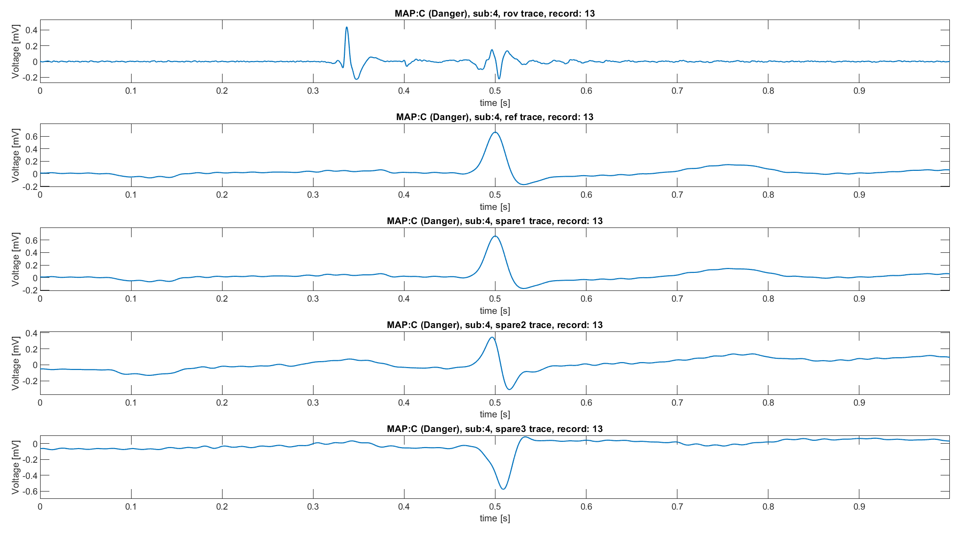
Knowledge on roving signals: recap
Map C
3 components: atrial activity, ventricular activity and His Bundle passage
Not fixed proportions between atrial and ventricular components
Clear and biphasic atrial component
ECG 1
ECG 1
ECG 2
ECG 3

Slide 10
Outline
Why building a heuristic classifier
Knowledge on roving signals: recap
Heuristic classifier: pseudo code
Performance
Conclusions

Slide 11
Heuristic classifier: pseudo code
For each roving trace (post-alignment):
Divide the trace in three segments:
Atrial: before t=0.35s
Ventricular: after t=0.5
His bundle: 0.35<t<0.5
Into each segment find, if there is, the main peak
Usage of find_peaks (python) with prominence set as a multiple of the SD of the segment, by trial and errors fixed at 6 times SD
Then apply the following set of rules:
Applied on both filtered and not filtered signals
Does the signal have an His peak?
No
Is the ventricular peak lower than atrial one?
Does the signal have a ventricular peak?
No
NB: in this way MAP B, effective, is harder to be chosen, leading to a more “conservative” algorithm, as is should be the surgeon.
MAP A, indifferent, is chosen even if the rules are not fully satisfied (e.g. noisy record), because the first condition is “does the signal have a ventricular peak”.
Finally, MAP C, dangerous, is chosen as first one if there’s a peak into the His bundle.
OR
MAP B
Yes
Yes
MAP C
MAP A

Slide 12
Outline
Why building a heuristic classifier
Knowledge on roving signals: recap
Heuristic classifier: pseudo code
Performance
Conclusions

Slide 13
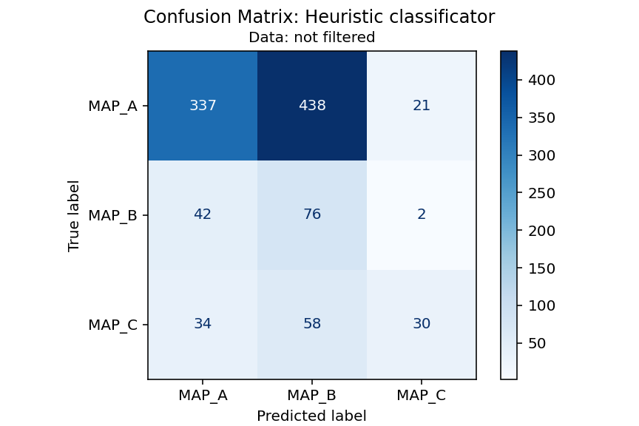

Heuristic classifier: results
Performance have been evaluated using confusion matrix and standard metrics

Slide 14




Heuristic classifier: results
 | Precision | Recall | F1-score | support
Map A | 0.82 | 0.42 | 0.56 | 796
Map B | 0.13 | 0.63 | 0.22 | 120
Map C | 0.57 | 0.25 | 0.34 | 122
Accuracy |  |  | 0.43 | 1038
Macro avg | 0.50 | 0.43 | 0.37 | 1038
Weighted avg | 0.71 | 0.43 | 0.49 | 1038
$$Precision=\frac{TP}{TP+FP}$$
$$Recall=\frac{TP}{TP+FN}$$
$$f1_{score}=2\frac{Precision ∗Recall}{Precision+Recall}$$
$$Accuracy=\frac{TP+TN}{TP+TN+FP+FN}$$

Slide 15
Outline
Why building a heuristic classifier
Knowledge on roving signals: recap
Heuristic classifier: pseudo code
Performance
Conclusions

Slide 16
Conclusions
A heuristic classifier has been built with the purpose to act as baseline from which starting further evaluations.
In general, performance are not satisfying, as it could be imaged. Precisely:
Map A, is fairly well classified, with sufficient f1-score and good precision, but low recall, meaning that there’s a huge percentage of FN.
Map B and C are bad classified, with a low f1-score. It should be noted that Map B has sufficient recall (i.e.,. FN are less than TP), while Map C has a sufficient precision (i.e., FP are less than TP)
Moreover, filtered data does not have difference with not filtered ones in terms of performances.
In conclusion the presented set of rules is a simple classifier, which can be used as baseline to start the classification with a true machine learning model.

